Slide 1
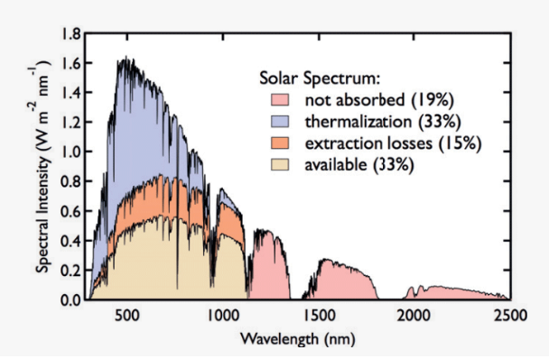
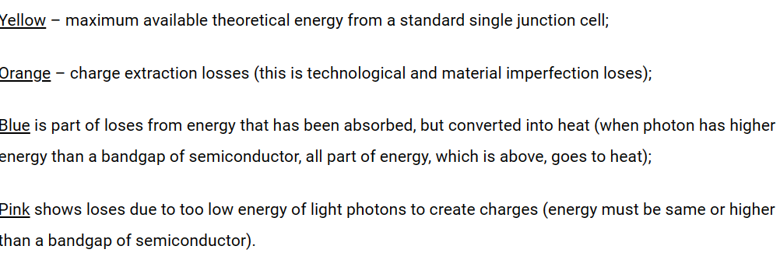
WHY TANDEM SOLAR CELLS

Slide 2
TANDEM SOLAR CELL
One method to increase the efficiency of a solar cell is to split the spectrum and use a solar cell that is optimized to each section of the spectrum.
Tandem solar cells can either be individual cells or connected in series. Series connected cells are simpler to fabricate but the current is the same though each cell so this contains the band gaps that can be used.
The most common arrangement for tandem cells is to grow them monolithically so that all the cells are grown as layers on the on substrate and tunnel junctions connect the individual cells.
Tandem cells are stacks of p-n junctions, each of which is formed from a semiconductor of different bandgap energy. As the number of bandgaps increases the efficiency of the stack also potentially increases. In reality, the semiconductor materials do not exist to allow for arbitrary materials with a specific bandgap and of high quality.

Slide 3
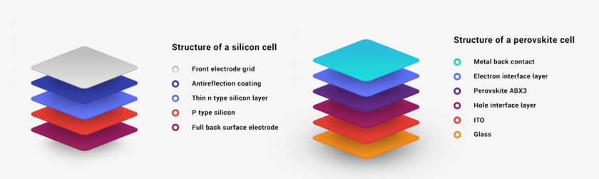
STRUCTURE OF TANDEM CELL

Slide 4
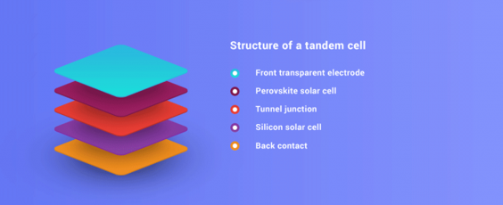
STRUCTURE OF TANDEM CELL

Slide 5
TANDEM SOLAR CELL
A tandem solar panel consists of 2 solar cells on top of each other.
In this case the top cell is made of perovskite. (The mineral perovskite, named after the Russian mineralogist Count Lev Perovski, was used in solar cells for the first time in 2009. Since then, scientists have demonstrated increasing energy yields from these perovskite solar cells in the laboratory )
This cell converts part of the solar spectrum into electricity and transmits the infrared light to the bottom silicon solar cell.
The silicon bottom cell is bifacial, which also converts the diffuse light that falls on the rear side of the panel to electricity.

Slide 6
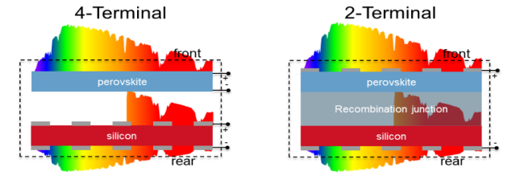
TANDEM SOLAR CELL

Slide 7
1. Two-Terminal (Monolithic) Tandem Solar Cells
Both sub-cells are grown or deposited on top of each other in a single monolithic structure.
They share one pair of electrical terminals.
The sub-cells are connected in series using a recombination layer (tunnel junction).
Examples: Perovskite/Silicon monolithic tandem, III-V on Silicon tandem
Advantages:
Higher efficiency potential
Lower electrical losses
Compact structure
Limitations:
Current matching is required between the top and bottom cell
Complex fabrication and material compatibility issues

Slide 8
2. Four-Terminal (Mechanical / Stacked) Tandem Solar Cells
The two sub-cells are fabricated independently and then stacked mechanically.
Each cell has its own pair of terminals.
They operate electrically independent, no current matching required.
Examples:
Perovskite solar cell stacked over c-Si cell
Organic solar cell + Si tandem
Advantages:
No need for current matching
Easier material combination
Each cell can operate at its optimum point
Limitations:
More optical losses due to extra layers
Slightly lower efficiency potential compared to monolithic

